Slide 1
Certification of Avionics Embedded Systems
s
presented by:
Shawn Coyle
john@marinvent.com

Slide 2
Presentation of teachers
John Maris
President of Marinvent Corporation
Awarded the 2005 Trans-Canada (McKee) trophy “...for outstanding achievement in the field of air operations.”
2005 Aviation Week and Space Technology Laureate for contributions in the fields of Aviation Information Technology and Electronics.
Transport Canada Delegated Test Pilot (DAR 305) with Airline Transport Pilot’s licenses from Canada, EASA, and the United States. Ratings include single and multi-engine land and sea, flight engineer, and flight instructor (airplanes and helicopters).
Previously served twelve years in the Canadian Armed Force as a Project Officer and Experimental Test Pilot. Final military assignment: International Space Station Program Canadarm2 MCE Manager.
Author of numerous patents and technical papers.
Fellow of the Canadian Aeronautics and Space Institute.
Associate Fellow of the American Institute of Aeronautics and Astronautics.
Associate Fellow of the Society of Experimental Test Pilots.

Slide 3
Presentation of teachers (cont’d)
Shawn Coyle
Join Canadian Air Force and graduated from fixed wing flying training in 1974
Helicopters followed immediately afterward, flew the Canadian version of the UH-1N in tactical support role
Join Bell Helicopter for the model 400 project in Fort Worth
Four years instructing at the US Naval Test Pilot School at Patuxent River
Work at Transport Canada as certification test pilot on Bell 407, 430 and 427 as well as a slew of smaller STC and FMS projects
Author of a book, ‘The Art and Science of Flying Helicopters’ updated and called ‘Cyclic and Collective’ in 2003
Currently engaged in technical marketing for Marinvent Corporation

Slide 4
Presentation of teachers (cont’d)
Sam Grainger
20 years of experience including certified, mission critical, and embedded software, object oriented programming, and quality assurance processes and procedures.
Has provided certification support for many certification programs including electronic charts for Jeppesen, the NASA AGATE program, UASC, Garmin, Honeywell, Rockwell Collins, among others.
Has given short courses in software certification through the Flight Test Center of Excellence and at Transport Canada’s delegate training course, and is the project manager for critical flight test software used by the Bombardier Flight Test Center C-Series flight test program.

Slide 5
MGA 855 – Course Content
Chapter 1
  Introduction and History of Aircraft Certification
  Canadian Aviation Regulations
  Avionics Certification
Chapter 2
  Developing a Plan to Certify Using DO-178B
  Configuration Management
  Quality Assurance for Avionics Systems
  Integration of Embedded Avionics

Slide 6
MGA 855 – Course Content (cont’d)
Chapter 3
  Design to DO-254
  Validation and Verification Testing
  Criticality Levels (Advisory Circular 20-152)
  Failure Modes Effects Analysis
Chapter 4
  Practical Testing and Certification Basis
  Procedures for New concepts
  Technical Standards Orders
  Supplemental Type Certificates

Slide 7
Certification of Embedded Avionics Systems
In collaboration with Marinvent Corporation
Chapter 1.1
Introduction to Avionics Certification
presented by :
Shawn Coyle
Shawn.coyle@marinvent.com

Slide 8

Caution
    This module is designed to show the application of the certification principles contained in the others chapters. As such, it touches upon many aspects of the certification process, but the material is not complete, comprehensive, or necessarily current with the latest regulations and guidance materials. For these reasons, the analysis contained in the following slides should not be used as the basis of a certification program for the system under investigation.

Slide 9
Summary
    1.1 Introduction
      1.1.1 Course objectives
      1.1.2 Application Context
      1.1.3 History of Type Certification
      1.1.4 International Civil Aviation Organization (ICAO)
      1.1.5 Bilateral Agreements
      1.1.6 Evolution Context for Certification
      1.1.7 Type of Certification
      1.1.8 Specific Terminology
      1.1.9 What You May Not Realize
      1.1.10 Continuum of Safety
      1.1.11 Responsibilities in Type Certification
      1.1.12 Approval
      1.1.13 New Airframe TC

Slide 10
Summary
    1.2 Airworthiness Regulation
      1.2.1 Canadian Regulation
      1.2.2 Standards
      1.2.3 Advisory Circulars (ACs)
      1.2.4 Technical Standards Orders (TSO)
      1.2.5 RTCA

Slide 11
Summary
    1.3 Certification Process
      1.3.1 Types of Certification
      1.3.2 Type Certification Part 1
      1.3.3 Type Certification Part 2
      1.3.4 Type Certification Part 3
      1.3.5 Equivalent Level of Safety
      1.3.6 Special Conditions
      1.3.7 Design Certification
      1.3.8 Certification Plan
      1.3.9 Certification Philosophy
      1.3.10 General Compliance Plan
      1.3.11 Some methods of Compliance
      1.3.12 Findings of Compliance
      1.3.13 Compliance Plans are not stagnant
      1.3.14 Original Compliance Record
      1.3.15 Back to Test Plans
      1.3.16 Issue Papers or Certification Review Items (CRIs)
      1.3.17 Type Inspection Authorization or Engineering Inspection
      1.3.18 Test Witnessing

Slide 12
1.1.1 Course Objectives
An Introduction to aeronautic certification process philosophy, as a first contact to the certification obligations of this industry, with the primary objective of demystifying the overall certification process.
Condensed in 39 hours class courses, divided in four chapters such as
  History of Certification and Canadian Regulation
  Certification of Embedded Avionics
  Analysis and certification of embedded systems
  Practical trials, software, equipment and avionic systems
24 hours of laboratories, including 6 case studies and 3 practical projects based on real industrial situations, with the use of avionic systems, advanced flight simulator for systems integration, and an aircraft – flying test bench.

Slide 13



1.1.2 Application Context
Civil Certification is a complex process involving civilian authorities, applicants (industries, operators), advisory documents, know how, experience, certification approach, design & engineering, etc.
Much depends on the Civil authority, applicant and authorities work environment and collaboration
Various levels of civilian authorities exists(ex. TCCA, FAA, EASA, Zimbabwe – since 1999)
This course is based on the “Canadian” way (certification process)
  FAA very similar
  Europe differs slightly
Figure 1.1.1 – Transport Canada logo
Figure 1.1.2 – FAA logo
Figure 1.1.3 – EASA logo

Slide 14
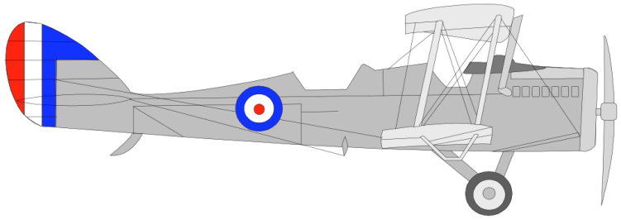
1.1.3 History of Type Certification
History of Type Certification Process
USA as model
  That is where aviation got its major start
Barnstorming!
  no controls
1911- Airmail
  Long Island demonstration
1918 Airmail Service
1921 Transcontinental Airmail
  Two months - 2000 injuries
Political Problem
Figure 1.1.4 - Plane
Notes:
barnstorming pilots had no license but also had no media to worry about
airmail initially day only
2 days coast to coast with plane/train
transcontinental day & night

Slide 15
1.1.3 History of Type Certification
Commerce Act of 1926
Department of Commerce
  Aeronautics Branch
    “Foster Air Commerce”
    Establish Airways and Navigation Aids
    License Pilots
    Issue Airworthiness Certificates
    Investigate Accidents
= Regulation
Notes:
#1 mission of Air commerce was to foster air commerce
Investigation of accidents was to provide feedback for nav aids, licensing and airworthiness certificates

Slide 16
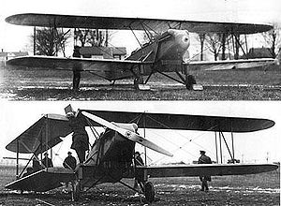
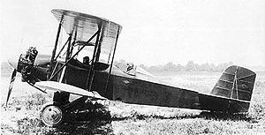
1.1.3 History of Type Certification
Type Certificate
1927
  First TC issued by Aeronautics Branch
  of Department of Commerce
  T.C. Buhl Airster C-3A
Figure 1.1.5 - Buhl Airster C-3A
Figure 1.1.6 – Buhl Airster C-3A
Notes:
now on order of 0-5 type certificates per year for FAA

Slide 17
1.1.3 History of Type Certification
1938 Civil Aeronautics Authority (CAA)
  Updated earlier legislation
Air Safety Board to investigate accidents
  Civil Aeronautics Board (CAB)
  Civil Aeronautics Authority (CAA)
Introduce Civil Airworthiness Regulation (CAR) “Airworthiness Requirements for Aircraft”
  CAR 4 Transport Aircraft
  CAR 3 Normal, utility and acrobatic
  CAR 13 Engine Airworthiness Requirements
  CAR 14 Propeller Airworthiness Requirements

Slide 18
1.1.3 History of Type Certification
Civil Aeronautics Authority (CAA)
1946
  Delegated Type and Production Certificates
1947
  ICAO Established by Chicago Convention
  Established Technical Standard Orders (TSO)
    Expanded Experimental Certificates
1950
  Increased Delegation of Authority
1951
  DOA (Delegated Option Authorization)
    DER (Delegated Engineering Representative)
      Test Pilot, Analysts, Systems, Structures, Flutter, Etc. . .
      1995 - 10 times more DER’s than FAA certification personnel.

Slide 19
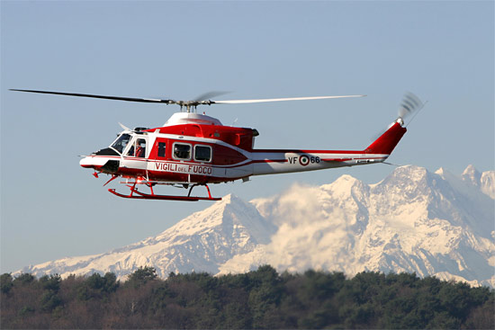
1.1.3 History of Type Certification
1956 - Adds Helicopters
CAR 6
  Airworthiness Requirements for Normal Category Helicopters
CAR 7
  1956: Rotorcraft Airworthiness; Transport Categories
  Airworthiness Requirements for
  Transport Category Helicopters
Figure 1.1.7 – The Bell 412 Helicopter

Slide 20
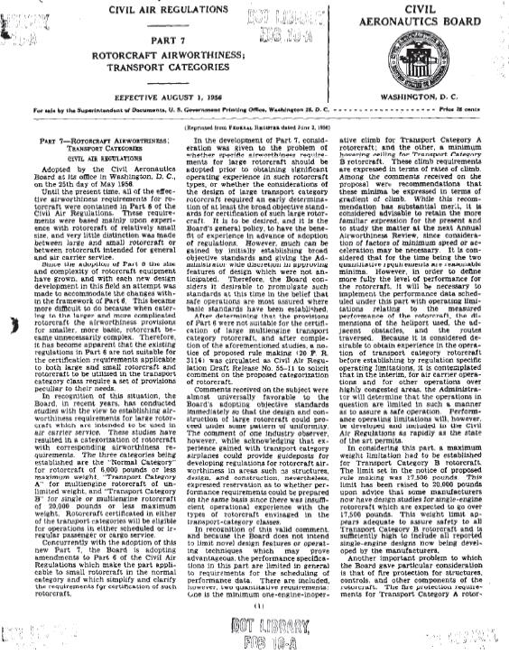
1.1.3 History of Type Certification
1956 - Adds Helicopters
Figure 1.1.8 – CAR 7 initial document - 1956

Slide 21
1.1.3 History of Type Certification
Federal Aviation Act
1958
  CAR Changed to Federal Aviation Regulations (FARs)
    FAR Part 33 Aircraft Engines
    FAR Part 35 Propellers
    FAR Part 36 Noise Standards
  Proper name now
    Title 14, Code of Federal Regulation (14 CFR)
1967
  FAA Order 8110.4 Type Certification

Slide 22

1.1.4 ICAO – International Civil Aviation Organization
Definition
  Agency of the United Nations
  Makes standards for airworthiness
  Headquarters located in Montreal, Quebec
Made up of an Assembly, a Council and a Secretariat
  Assembly
    Meet every three years
    Composed of representatives of each Contracting State
    Review in details the work of ICAO, vote triennial budget
Figure 1.1.9 – ICAO logo

Slide 23
1.1.4 ICAO (cont’d)
  Council
    Governing body elected by the Assembly every three years
    36 states: States with a major importance in air transport, providing equipment and facilities and representing all major areas of the world
    Gives continuing direction to ICAO work
  Secretariat
    Headed by a Secretary General
    Five main divisions:
      Air Navigation Bureau
      Air Transport Bureau
      Technical Co-operation Bureau
      Legal Bureau
      Bureau of Administration and Services
    International approach reflected by a large geographical basis recruitment

Slide 24
1.1.4 ICAO – Annexes
ICAO is supported by 18 annexes established in the Chicago Convention
Contains Standards and recommended practices
Regularly amended by ICAO

Slide 25
1.1.4 ICAO – Annexes (cont’d)
Annex 1 - Personnel Licensing
Annex 2 - Rules of the Air
Annex 3 - Meteorological Service for International Air Navigation
Annex 4 - Aeronautical Charts
Annex 5 - Units of Measurement to be used in Air and Ground Operations
Annex 6 - Operation of Aircraft
Annex 7 - Aircraft Nationality and Registration Marks
Annex 8 - Airworthiness of Aircraft
Annex 9 - Facilitation
Annex 10 - Aeronautical Telecommunications
Annex 11 - Air Traffic Services - Air Traffic Control Service, Flight Information Service and Alerting Service
Annex 12 - Search and Rescue
Annex 13 - Aircraft Accident and Incident Investigation
Annex 14 - Aerodromes
Annex 15 – Aeronautical Information Services
Annex 16 - Environmental Protection
Annex 17 - Security: Safeguarding International Civil Aviation Against Acts of Unlawful Interference
Annex 18 - The Safe Transport of Dangerous Goods by Air

Slide 26
1.1.4 ICAO – Annex 8
Each state sets up own Airworthiness System
  Design
  Construction
  Operation
    Ex. TC/CA, FAA, EASA
Broad Overview in ICAO Airworthiness Technical Manual
  In electronic documentation

Slide 27
1.1.4 ICAO – Annex 8 (cont’d)
Sets
  Design Standards
    Passenger safety, etc.
  Performance Standards
    Takeoff distance, rate of climb, etc.
  Reliability Standards

Slide 28
1.1.5 Bilateral Agreements
Provides airworthiness cooperation between two civil aviation organizations
Two principal types:
  Bilateral Airworthiness Agreements
    Up to 1996
    Executive agreement for exchange of diplomatic notes
  Bilateral Aviation Safety Agreements
    Bilateral cooperation in a variety of aviation areas, including maintenance, flight operations, and environmental certification
    For certification, an additional document (Implementation Procedures for Airworthiness) is required
  Large international harmonization effort to make sure that the same certification rules are used by everyone

Slide 29
1.1.6 Evolution Context for Certification
Electronics has only entered into the picture in the last 30 years
Computers only in the last 20 years
Embedded Avionics only in the last 10 years
Not the same as just new type of engine...

Slide 30
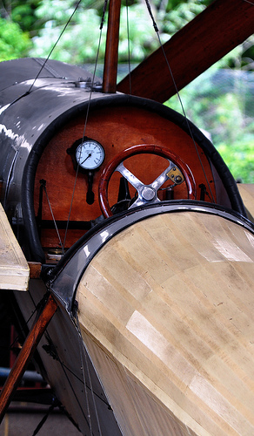
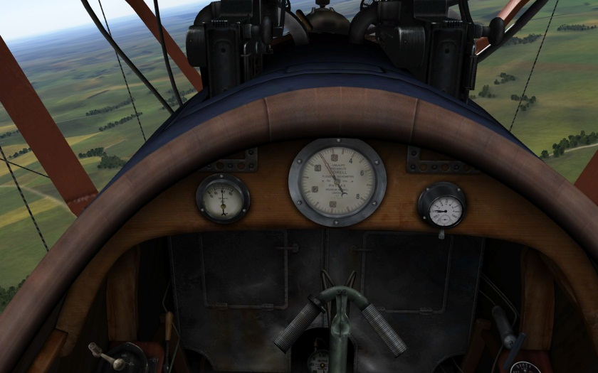
1.1.6 Evolution Context for Certification
Les années 1910
Figure 1.1.11 Pfalz D3 cockpit - 1918
Figure 1.1.10 Blackburn monoplane cockpit - 1910

Slide 31
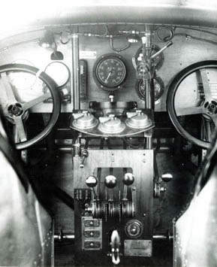
1.1.6 Evolution Context for Certification
Les années 1920
Figure 1.1.12 Fokker F-III Cockpit, 1925

Slide 32
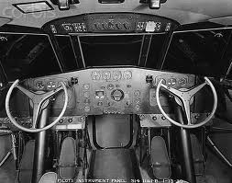
1.1.6 Evolution Context for Certification
Les années 1930
Figure 1.1.13 Cockpit Boeing 314 Clipper, 1939

Slide 33
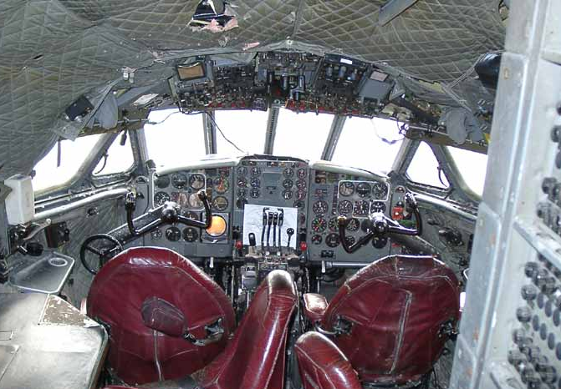
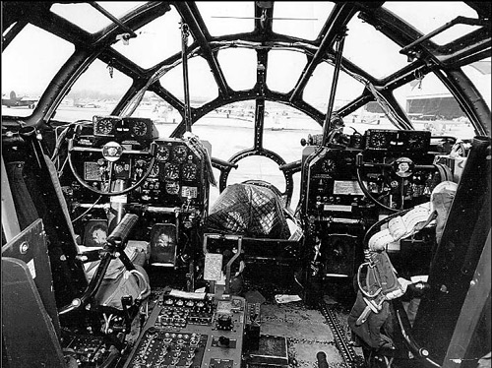
1.1.6 Evolution Context for Certification
Les années 1940
1.1.15 DeHavilland Comet 4 cockpit, 1949
1.1.14 Boeing B-29 cockpit, 1944

Slide 34
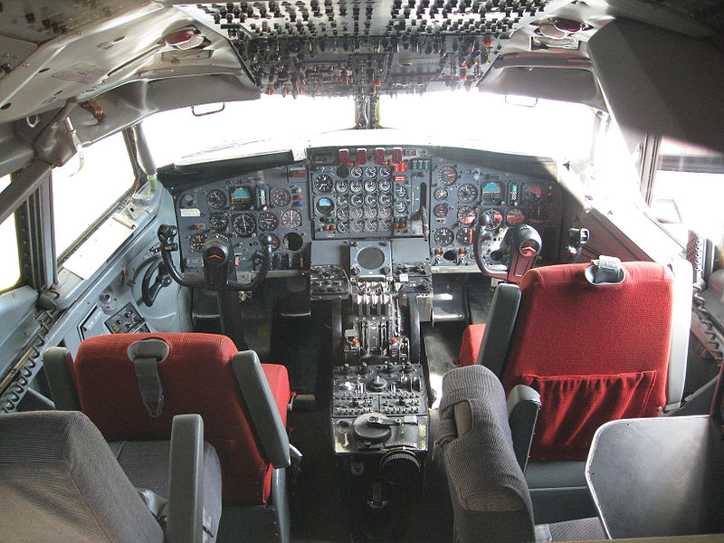
1.1.6 Evolution Context for Certification
Les années 1950
Figure 1.1.16 Cockpit Boeing B-707, 1959

Slide 35
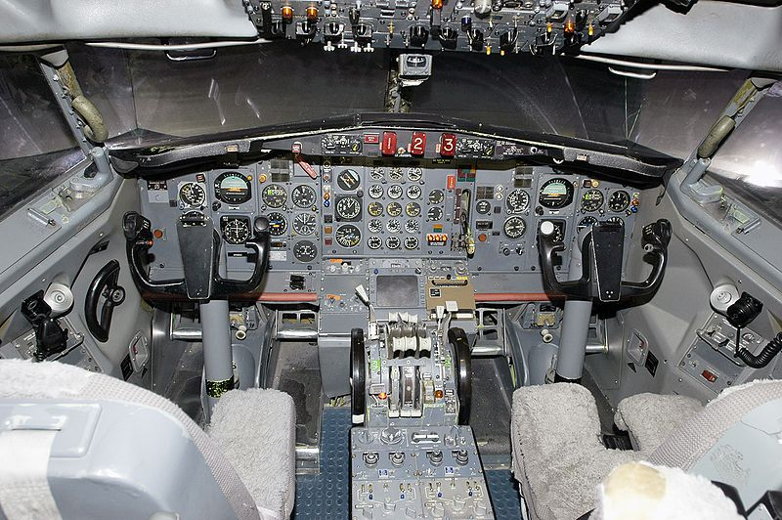
1.1.6 Evolution Context for Certification
Les années 1960
Figure 1.1.17 Cockpit Boeing B-727, 1963

Slide 36
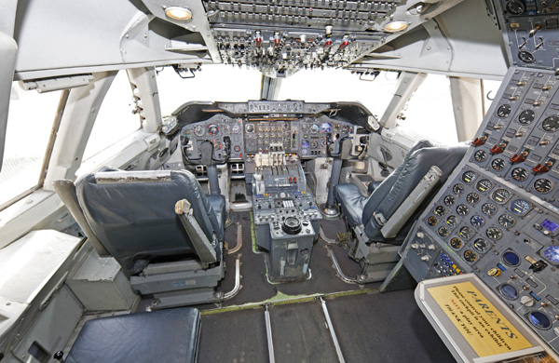
1.1.6 Evolution Context for Certification
Les années 1970
Figure 1.1.18 B-747-100 cockpit 1970

Slide 37
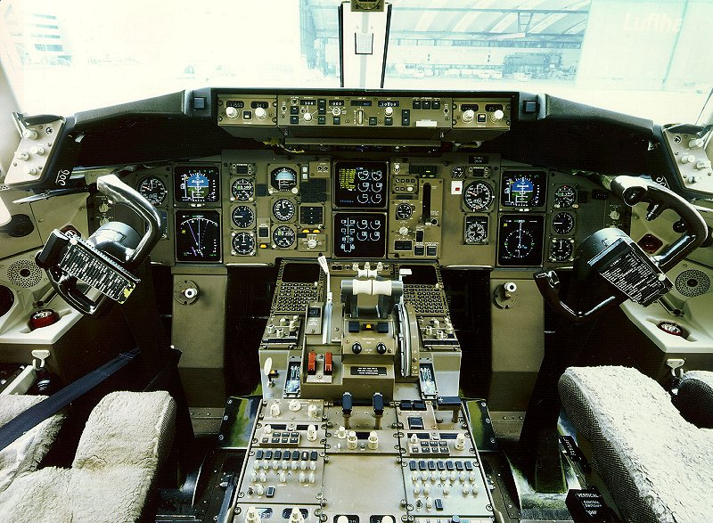
1.1.6 Evolution Context for Certification
Les années 1980
Figure 1.1.19 Boeing B-767 cockpit, 1985

Slide 38
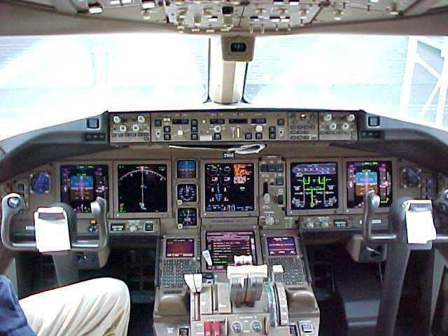
1.1.6 Evolution Context for Certification
Les années 1990
Figure 1.1.20 Cockpit Boeing B-777, 1995

Slide 39
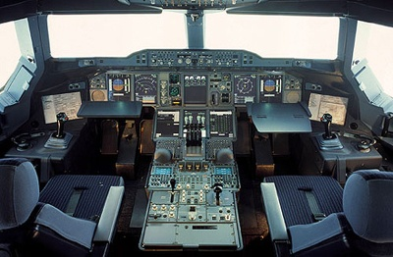
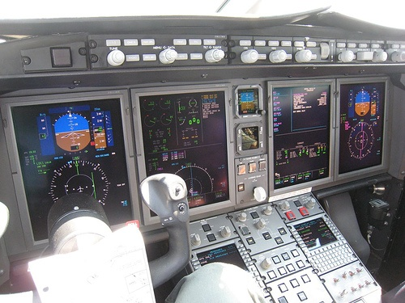
1.1.6 Evolution Context for Certification
Les années 2000
Figure 1.1.22 Airbus A-380 Cockpit
Figure 1.1.21 Challenger 300 cockpit

Slide 40
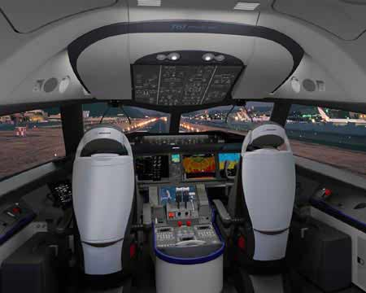
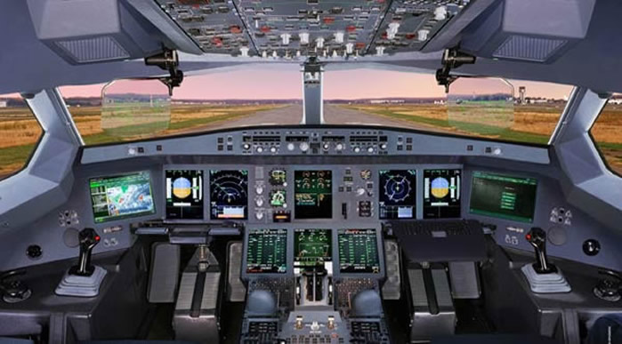
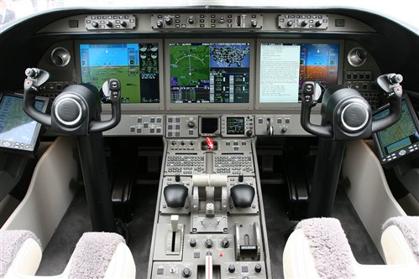
1.1.6 Evolution Context for Certification
Les années 2010
Figure 1.1.23 Boeing B-787 Cockpit
Figure 1.1.24 Airbus A-350 Cockpit
Figure 1.1.25 Bombardier Lear 85 Cockpit

Slide 41
1.1.6 Evolution Context for Certification
There is no perfect:
  Hardware Design
  Software Code
  Regulation, Rule, Requirement or Standard
  Manufacturer
  Operator
  Maintainer
  Certification Authority
  Operational Authority
Industry technologies are always ahead of certification processes

Slide 42
1.1.6 Evolution Context for Certification
Certification Challenge
  Customer demands, engineering and technological limits vs. regulations, requirements
  Request a continuous teamwork of all those involved
Certification is NOT:
  Simple
  Easy
  Cheap
  Well understood by those outside the certification business
Essential part of aircraft business
Take two years to feel comfortable about certification

Slide 43
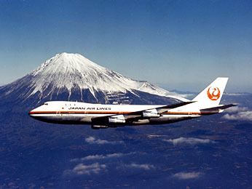
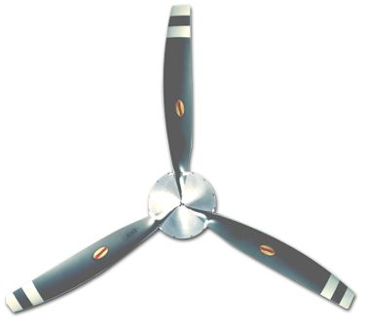
1.1.7 Types of Certification
Type
  Approval of aircraft, engine, propeller or parts
    Aircraft: B747-100, P-180, C-172N
    Engine: PT6-A66B, CFM56…
    Propeller: HARTZELL...
    Parts: hydraulic pomp, brakes, FMS…
    This is the only part we’re interested in
Not in this course
  Individual Airframe
    Production
    Operational
    Personnel
Figure 1.1.26 – B747-100
Figure 1.1.27 –Hartzell propeller HC-E3YR-LF/FLC8468-4R

Slide 44
1.1.8 Specific Terminology
Some Definitions
Need to be mastered / understood
  In order to talk to the authority properly
Like any discipline:
  There are certain words that have very specific meanings

Slide 45
1.1.8 Specific Terminology
To Avoid Confusion
TC
  Will only mean Type Certificate
TCCA
  Will be used for Transport Canada Civil Aviation

Slide 46
1.1.8 Specific Terminology
Airframe
All basic structure
  Primary, secondary
  Plus all components unless part of engine or propeller
    Landing gear
    Accessories
    Controls
    All airfoil surfaces
Systems
  Everything Else

Slide 47
1.1.8 Specific Terminology
“Authority”
  Transport Canada Civil Aviation (TCCA), Canada
  Federal Aviation Administration (FAA), United States
  Direction Générale de l'Aviation Civile (DGAC), France
  Civil Aviation Authority (CAA), United Kingdom
Company / Applicant
  You, Bombardier, SMEs, etc.
Operator
  Those using the aircraft in everyday service, Air Canada, FedEx, Execaire (Cirque du Soleil)…
Certification
  Type
  Production
  Airworthiness

Slide 48
1.1.8 Specific Terminology
Terms to Become Familiar With
Airworthy
Airworthiness Criteria
Certificate of Airworthiness (CofA)
Compliance
Conformity
Type Design
Type Certificate (TC)
Type Certificate Data Sheet (TCDS)

Slide 49
1.1.8 Specific Terminology a) Airworthy
Certified by a competent authority that the aircraft meets the specified airworthiness criteria
  Design complies with the standard / requirement
  Manufactured in conformity to the approved design
  Operate the aircraft within approved limits
  Maintain the aircraft in accordance with the approved documents
  Monitoring and correcting problems as they occur
  Approve modifications and repairs in accordance with established criteria
“In a fit and safe state for flight and in conformity with the type design”

Slide 50
1.1.8 Specific Terminology b) Airworthiness Criteria
Minimum acceptable properties and characteristics of:
  Configuration
  Material
  Construction
  Performance
  Maintenance
  Other physical properties

Slide 51
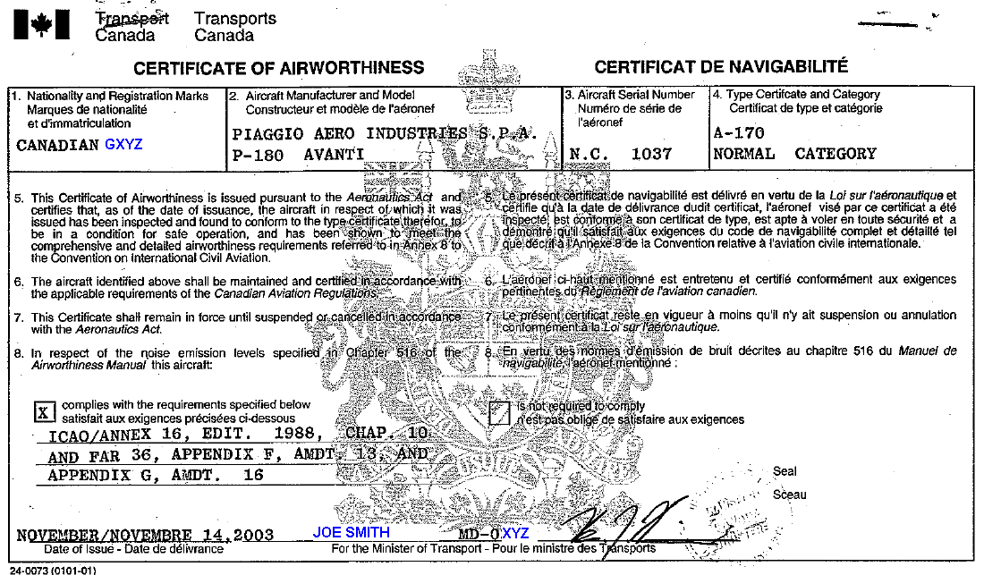
1.1.8 Specific Terminology c) Certificate of Airworthiness
Given to individual aircraft
Renewed on regular basis
“when operated and maintained in accordance with the limitations set down
in the Type Certifi-
cate Data Sheet”
Figure 1.1.28 Certificate of Airworthiness

Slide 52
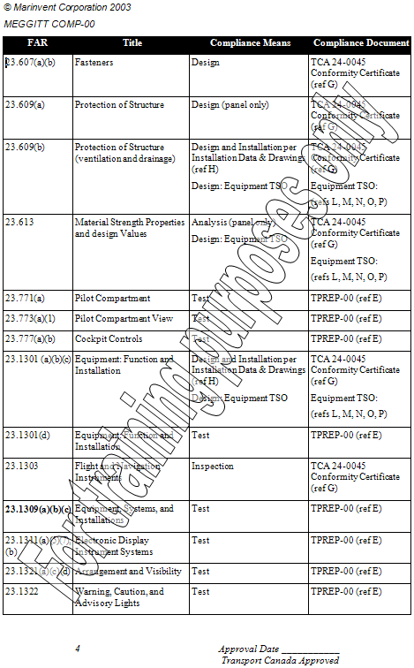
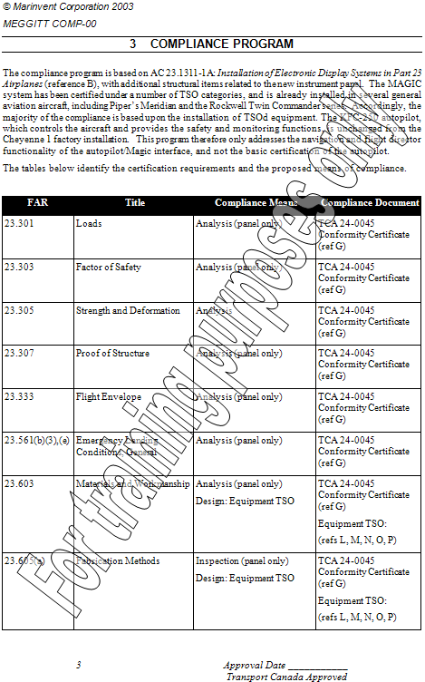
1.1.8 Specific Terminology d) Compliance
Meets the
standards or
requirements
Figure 1.1.29 Compliance program

Slide 53
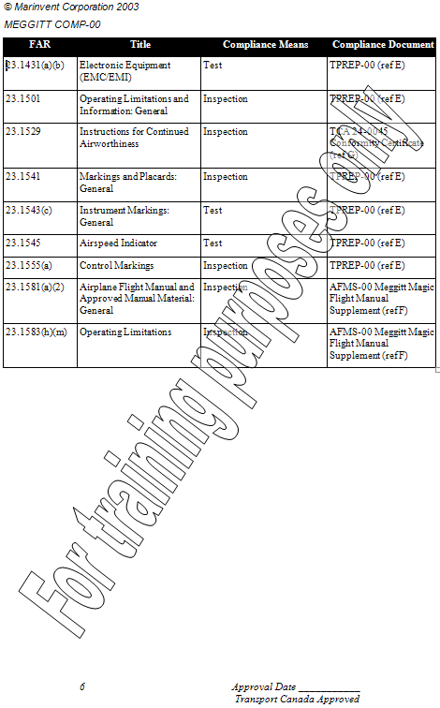
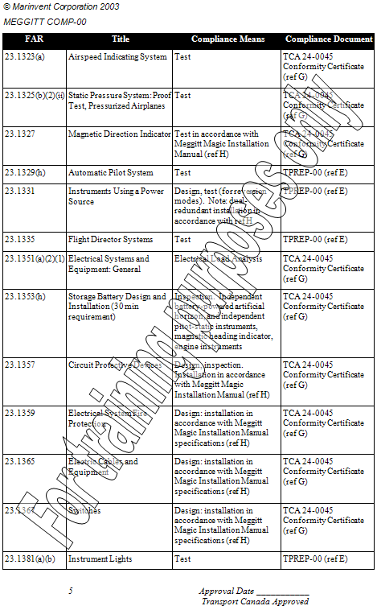
1.1.8 Specific Terminology d) Compliance

Slide 54
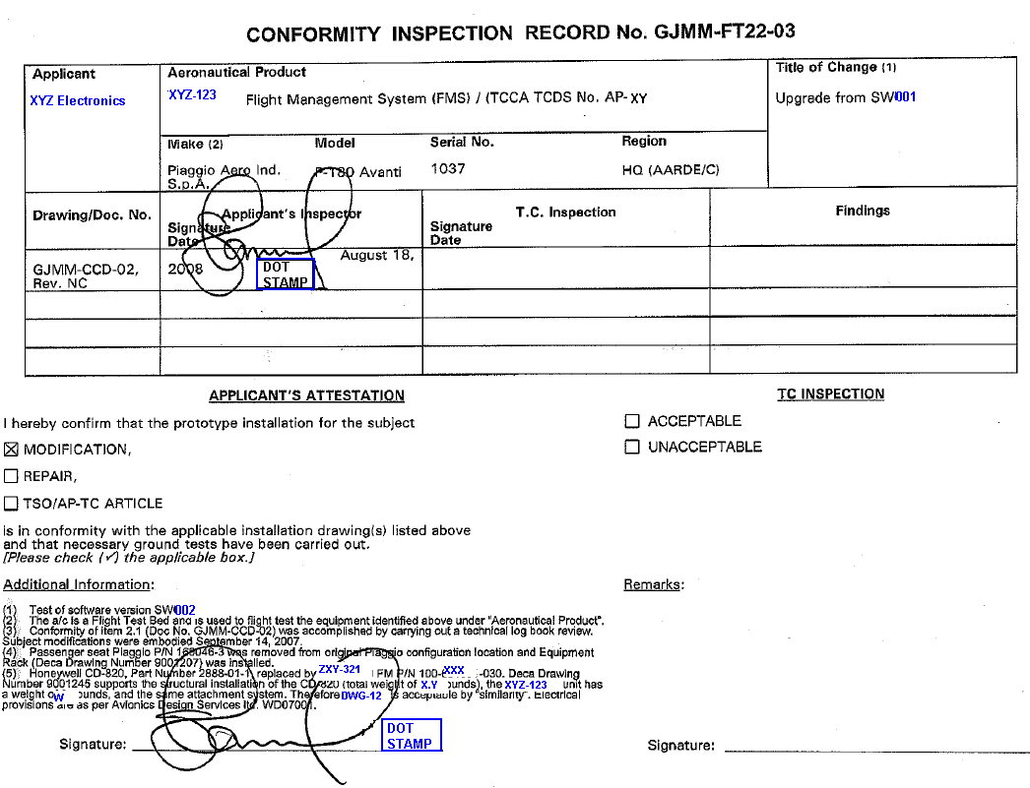
1.1.8 Specific Terminology e) Conformity / Conforms
The aircraft / article agrees with the drawing and description
Figure 1.1.30 Conformity Inspection
Figure 1.1.30 Conformity Inspection Report

Slide 55
1.1.8 Specific Terminology
Complies
Airworthiness Requirements / Standards
Type Design
Conforms
Condition
Aeronautical Product
Airworthy

Slide 56
1.1.8 Specific Terminology f) Type Design
Type Design consists of
  Drawings
  Specifications
  Listings of drawings and specifications required to define configuration and design features
  Information on dimensions, materials and processes
  Airworthiness limitations section of the instructions for Continued Airworthiness

Slide 57
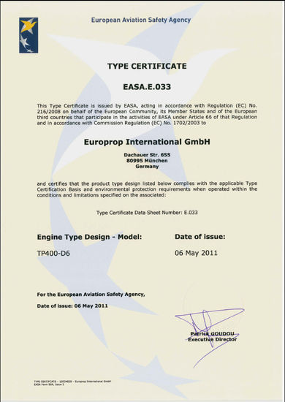
1.1.8 Specific Terminology g) Type Certificate (TC)
Document certifying that the
type design meets the applicable
standards as recorded in the
Type Certificate Data Sheet
(TCDS)
Figure 1.1.31 – Type Certificate EASA.E.033

Slide 58
1.1.8 Specific Terminology h) Type Certificate Data Sheet (TCDC)
Contains all the description of the aircraft, engine and propeller.
Lists all information and limitations
  Airspeed limits
  Weight limits
  Thrust limitations

Slide 59
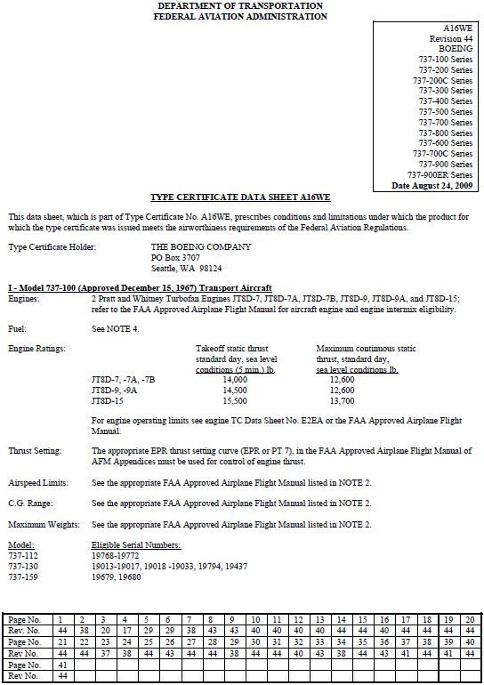
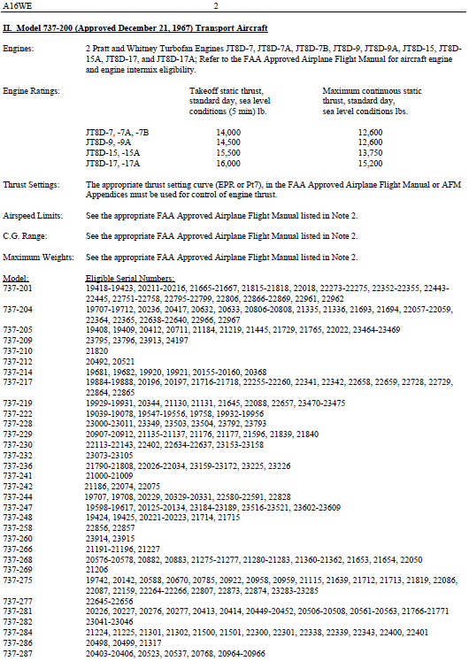
1.1.8 Specific Terminology h) Type Certificate Data Sheet (TCDC)
Figure 1.1.32 – Type Certificate Data Sheet

Slide 60
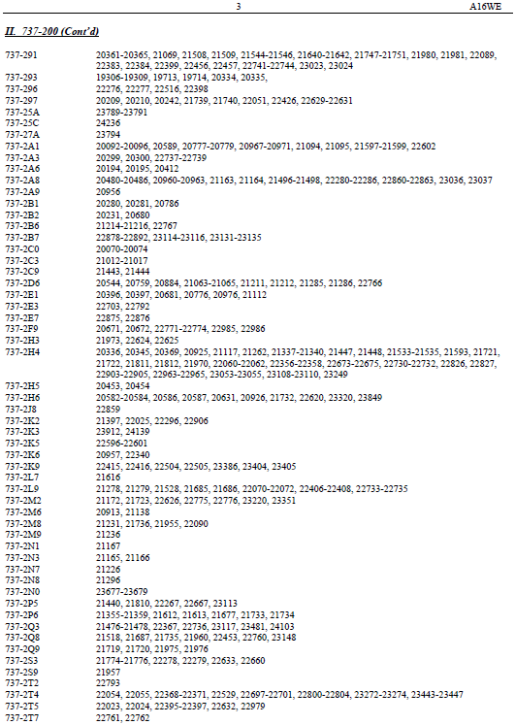
1.1.8 Specific Terminology h) Type Certificate Data Sheet (TCDC)

Slide 61
1.1.8 Specific Terminology i) Regulation / Rule
Law: Canadian Aviation Regulations (CARs)
  “The Canadian Aviation Regulations are a compilation of regulatory requirements designed to enhance safety and the competitiveness of the Canadian aviation industry. They correspond to the broad areas of aviation which Transport Canada, Civil Aviation is mandated to regulate (e.g. personnel licensing, airworthiness, commercial air services, etc.).”
In TCCA
  Part 521 is the Regulation

Slide 62
1.1.8 Specific Terminology j) Requirement
A document called by a rule or law
A characteristic that is stated in the certification requirement
I.e. 529.1309 requires certain things
Must be met in order to obtain certification

Slide 63
1.1.8 Specific Terminology k) Standard
A way of demonstrating compliance with a requirement

Slide 64
1.1.8 Specific Terminology l) Guidance Material
Other amplifying material to support the requirement but:
  Does not have the force of law
    ‘one way, but not the only way to demonstrate compliance’
  Includes Advisory Circulars (AC), FAA Orders, Policy Documents

Slide 65
1.1.8 Specific Terminology m) Certification Environment
Authority’s Main Concerns
  Reasonable level of safety
    Risk assessment methods
  Little concern about marketability of the product or financial success of the company
Successful Manufacturer’s Priorities
  Making Profit
    Time to Market
    Minimize Cost
  Competitiveness
  Safety
    Reputation

Slide 66
1.1.9 What You May not realize
Certification process is very inter-related process between applicant and authority
Success depends entirely on the management of this relationship
  Original Eclipse aircraft
    example of how not to do it
Technical challenges may be easier than the ‘politics’
  Like many other things in life

Slide 67
1.1.10 Continuum of Safety
Design
Manufacturing
Modifications and Repairs
Continuing Airworthiness
Operations
Maintenance

Slide 68
1.1.11 Responsibilities in Type Certification
Applicant
  Designs aircraft & uses detailed drawings to build components.
  Ground tests components.
  Flight tests aircraft & structural airframe.
Authority
  Finds compliance

Slide 69
1.1.12 Approval
TCCA Approval Activities
  Applications Data, Compliance Part 27, Part 33, Part 36 etc. .
  Functional & Reliability Tests - OT&E
  Maintenance Manual/Flight Manual
  Type Certification Data Sheet
TCCA Issues Type Certificate
  Type Design Consists of
    Drawings, Specifications, Materials, Processes, Etc. . .
Production Certificate
  Quality Control Procedures
Continuing Airworthiness
  AD’s etc. . .

Slide 70




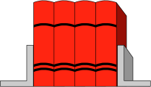

1.1.13 New Airframe TC
Design
Certification Basis
+
+
FAR’s
Data
Analysis
+
Documentation
Testing

Slide 71
1.1.13 New Airframe TC
Aircraft
Aircraft
Airframe
Airframe
Equipment
Equipment
Parts
Equipment
Engine
Engine
Propeller
Propeller
Appliances
Parts
Parts
Equipment
Parts
Equipment
Equipment
Parts
Equipment
Standard
Parts
Design
Parts
Appliances
Appliances
Appliances
Appliances
Standard
Parts
Design
Parts
Standard
Parts
Design
Parts

Slide 72
Summary
Brief history of regulation
Legal background to regulation
  International
  US

Slide 73
References
TCCA Advisory Circulars: http://www.tc.gc.ca/eng/civilaviation/regserv/cars/menu.htm/
Federal Aviation Administration: http://www.faa.gov/
Canadian Aviation Regulations: http://www.tc.gc.ca/eng/civilaviation/regserv/cars/menu.htm/
ICAO: http://www.icao.int/
Technical Standards Orders (TSO): http://www.faa.gov/aircraft/air_cert/design_approvals/tso/

Slide 74
Image References
Figure 1.1.1: http://www.namepa.net/images/partner_logos/conference_partners/transport_canada_logo_merged.gif
Figure 1.1.2: http://www.meddutch.com/sites/default/files/pictures/faa.gif
Figure 1.1.3: http://www.aviationnews.eu/blog/wp-content/uploads/2010/11/easa-logo.gif
Figure 1.1.5: http://upload.wikimedia.org/wikipedia/commons/thumb/6/6f/Buhl-cw3.jpg/300px-Buhl-cw3.jpg
Figure 1.1.6: http://upload.wikimedia.org/wikipedia/commons/thumb/5/54/J4_buhlverville.JPG/300px-J4_buhlverville.JPG
Figure 1.1.7: http://www.aerospace-technology.com/projects/bell-412/images/1-412-hellicopter.jpg
Figure 1.1.9: http://www.ask-rfid.com/Portals/0/Illustrations/News&Events/events/LOGO%20icao.jpg
Figure 1.1.10 to figure 1.1.25: Courtesy of Marinvent Corporation
Figure 1.1.26: http://www.jal.com/en/history/aircraft/70s/image/fig_01_b.jpg
Figure 1.1.27: http://temp.seabee-transitioncom.officelive.com/images/big_3blade_compact_scimitas.jpg
Figure 1.1.28 to figure 1.1.30: Coutesy of Marinvent Corporation
Figure 1.1.31: http://www.occar-ea.org/media/intemplate/104_Type_certificate.jpg
Figure 1.1.32: http://www.airweb.faa.gov/REGULATORY_AND_GUIDANCE_LIBRARY/RGMAKEMODEL.NSF/0/8176cb9e577981148625761c006610de/$FILE/A16WE_R44.pdf

